Slide 1

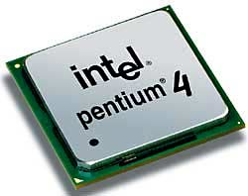
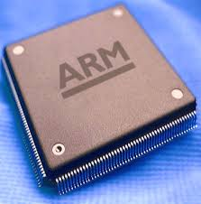
Microprocessor & Computer Architecture UE17CS253
UNIT-2
Session – 8
Performance Metrics, trends in Technology, Power and Energy

Slide 2
Performance Metrics
Performance:
A quantifiable measure of rate of doing (computational) work
Multiple such measures of performance
Delineated at the level of the basic operation
ops – operations per second
ips – instructions per second
flops – floating operations per second
Rate at which a benchmark program takes to execute
A carefully crafted and controlled code used to compare systems
Linpack Rmax (Linpack flops)
gups (billion updates per second)
others
Two perspectives on performance
Peak performance
Maximum theoretical performance possible for a system
Sustained performance
Observed performance for a particular workload and run
Varies across workloads and possibly between runs

Slide 3
Trends in Technology
Integrated circuit technology
Transistor density: 35%/year
Die size: 10-20%/year
Integration overall: 40-55%/year
Moore’s law: #transistors/sq inch doubled every 2 years
DRAM capacity: 25-40%/year (slowing)
Flash capacity: 50-60%/year
15-20X cheaper/bit than DRAM
Magnetic disk technology: 40%/year
15-25X cheaper/bit then Flash
300-500X cheaper/bit than DRAM
Trends in Technology

Slide 4
The PowerPlay

Slide 5
Transistors and Wires
Feature size
Minimum size of transistor or wire in x or y dimension
10 microns in 1971 to .032 microns in 2011
Transistor performance scales linearly
Wire delay does not improve with feature size!
Integration density scales quadratically
Trends in Technology

Slide 6
Power and Energy
Problem: Get power in, get power out
Thermal Design Power (TDP)
Characterizes sustained power consumption
Used as target for power supply and cooling system
Lower than peak power, higher than average power consumption
Clock rate can be reduced dynamically to limit power consumption
Energy per task is often a better measurement
Trends in Power and Energy

Slide 7
Dynamic Energy and Power
Dynamic energy
Transistor switch from 0 -> 1 or 1 -> 0
½ x Capacitive load x Voltage²
Dynamic power
½ x Capacitive load x Voltage² x Frequency switched
Reducing clock rate reduces power, not energy
Trends in Power and Energy

Slide 8
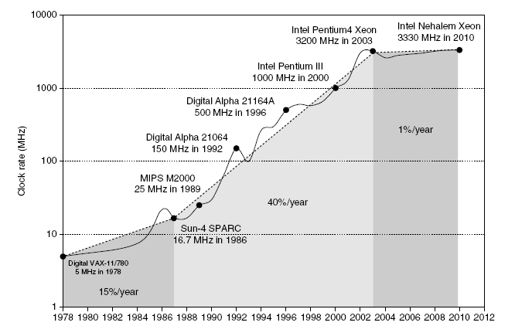
Power
Intel 80386 consumed ~ 2 W
3.3 GHz Intel Core i7 consumes 130 W
Heat must be dissipated from 1.5 x 1.5 cm chip
This is the limit of what can be cooled by air
Trends in Power and Energy

Slide 9
Reducing Power
Techniques for reducing power:
Do nothing well
Dynamic Voltage-Frequency Scaling
Low power state for DRAM, disks
Overclocking, turning off cores
Trends in Power and Energy

Slide 10
Static Power
Static power consumption
Current_{static} x Voltage
Scales with number of transistors
To reduce: power gating
Trends in Power and Energy

